Slide 1

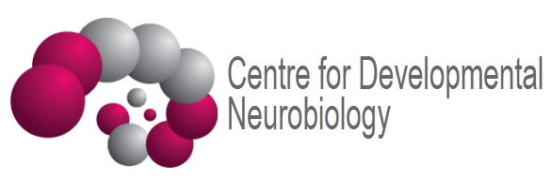
Electrical events in excitable tissues
Vincenzo Mastrolia
Research Associate
Centre for Developmental Neurobiology (CDN)
King’s College London

Slide 2
Learning outcomes
Describe how electrical events in excitable cells are measured
Describe the properties of cell membranes
Understand how Na+ and K+ ion channels contribute to generating the membrane potential (MP)
Understand the significance of the differential permeability of the membrane to Na+ and K+
Describe the establishment of electrochemical gradients
Describe the properties of the action potential (AP)
Explain the voltage and conductance changes during the AP
Explain what is meant by ‘threshold’ and ‘refractory periods’
Explain how the AP is conducted and the importance of myelin

Slide 3

Excitability
The ability of cells to change their membrane potential in response to stimuli
  Voltage, ligands, light, mechanical stimulation
Not just neurons
  Muscle cells, endocrine cells, cochlear hair cells, rods and cones in the retina
Expression of voltage- and/or ligand-gated ion channels
  Change in membrane potential trigger a conformational change which opens a pore
  Permeability to ions (Na⁺, Ca²⁺, K⁺, Cl⁻)

Slide 4
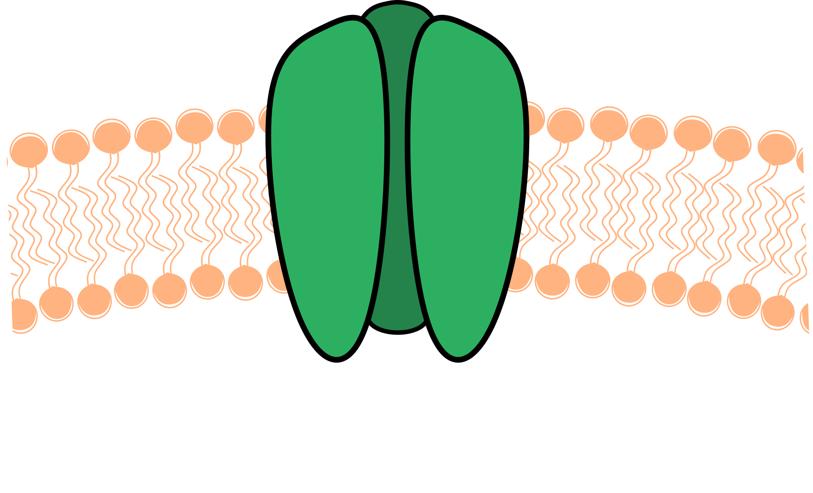
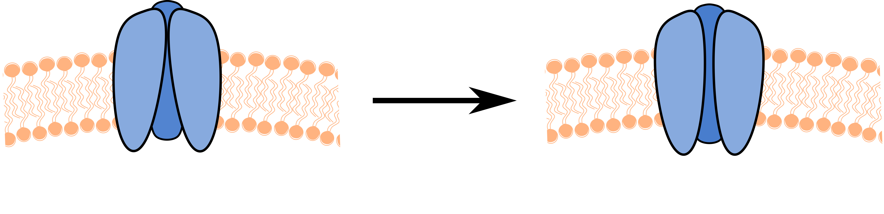
Ion channels
Transmembrane proteins
  Mono or multimeric
  Extracellular and intracellular domains
  Opening (pore)
Selective permeability (pore)
  Specific ions (Na⁺, K⁺, Ca²⁺, Cl⁻)
  Groups of ions (cations, anions)
Voltage-gated ion channels activate when reaching specific voltages
  Voltage sensors trigger
  conformational changes
Constantly open (leak)
Gated
Contribute to the resting membrane potential
Open in response to stimuli
Closed
Open
Voltage
Ligands
Light
Conformational
change

Slide 5
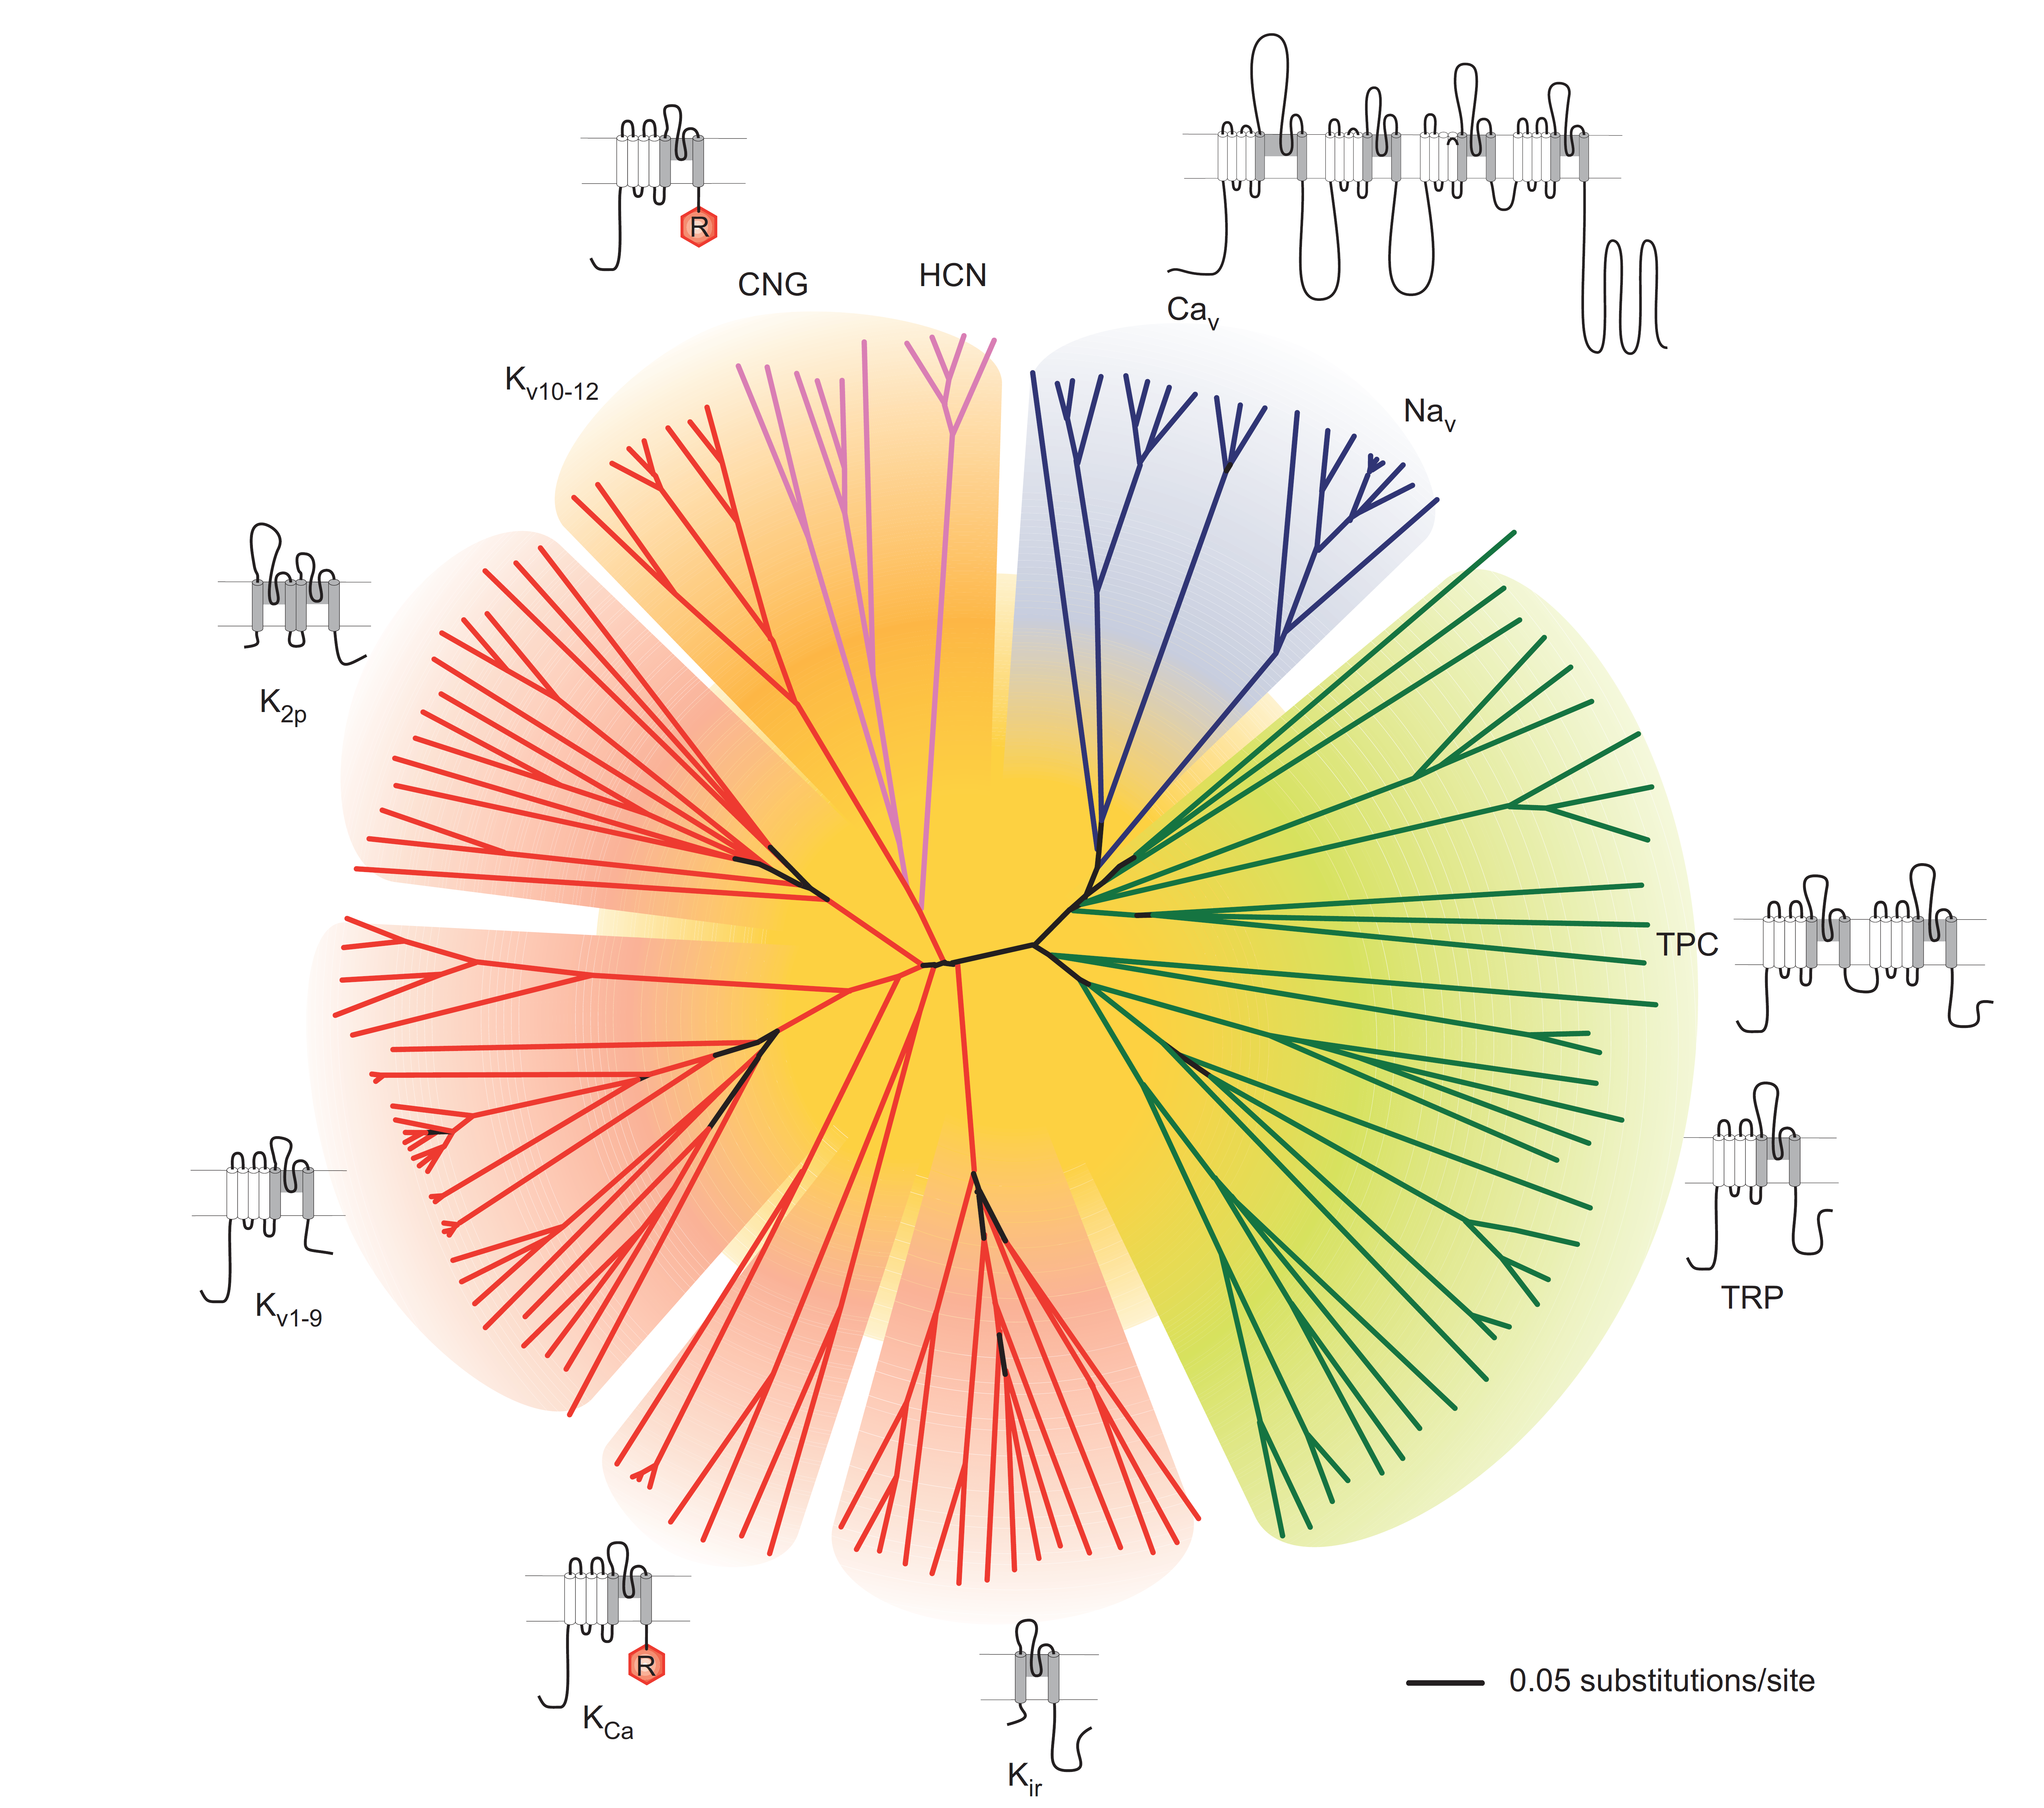
Ion channels families

Slide 6
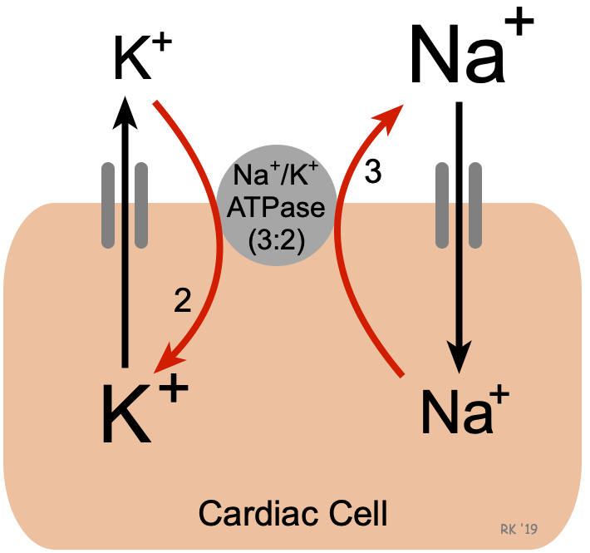
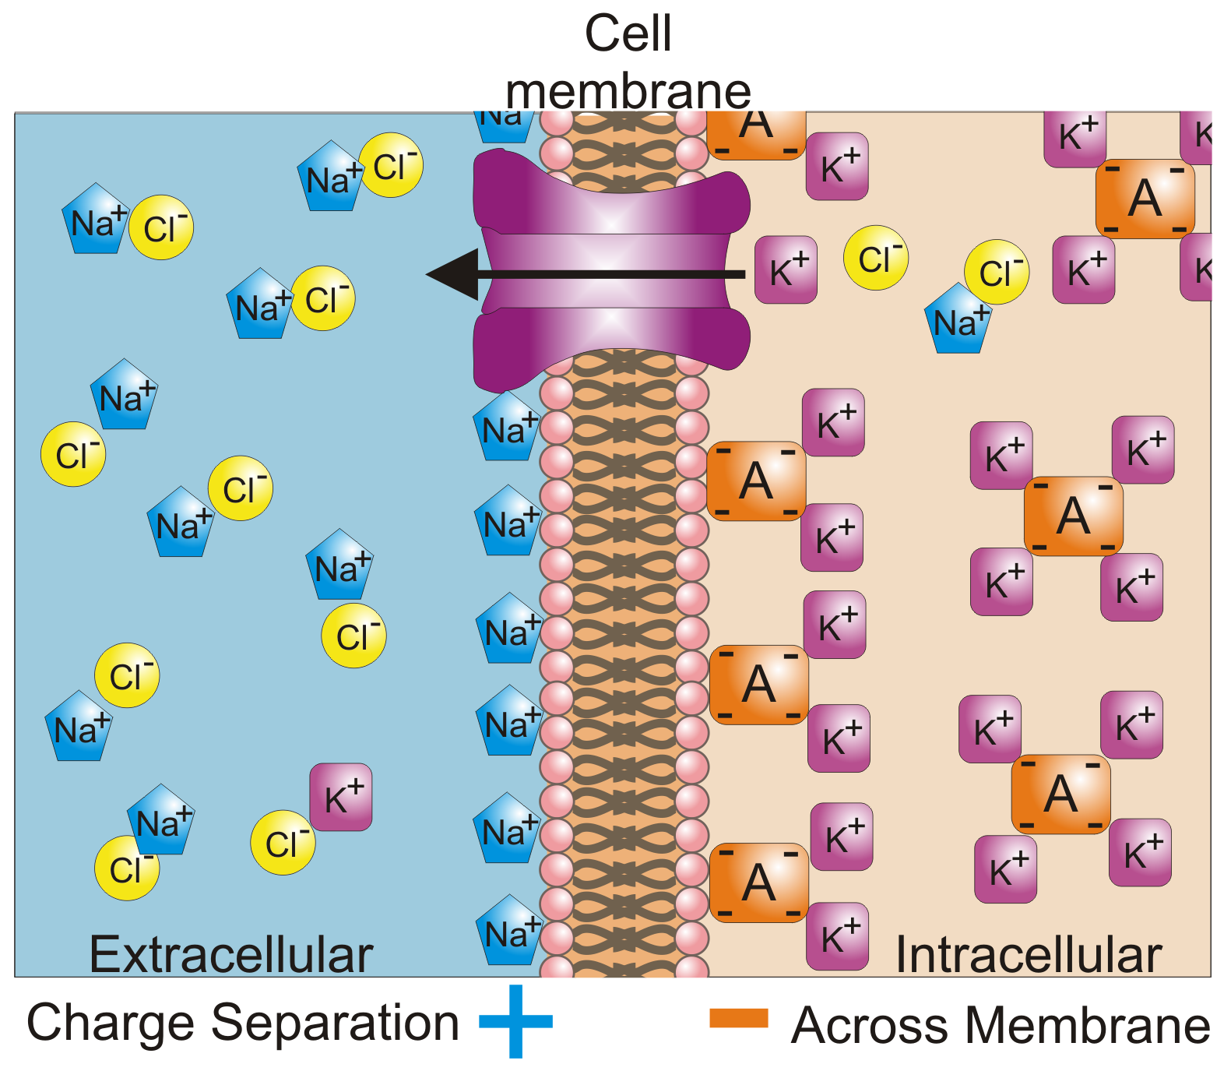
Resting membrane potential (voltage)
Na⁺/K⁺ ATPase keeps high extracellular Na⁺ and high intracellular K⁺
Imbalance of charges along the membrane
  Intracellular side of the membrane has a many negatively charged molecules (proteins, lipids, etc)
  Extracellular side of the membrane has many Na⁺ cations
  Ions can hardly pass through the membrane
High Na⁺
High K⁺
Extracellular
Intracellular

Slide 7
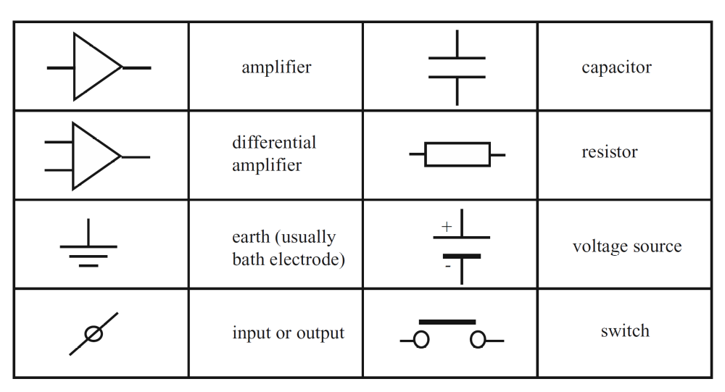
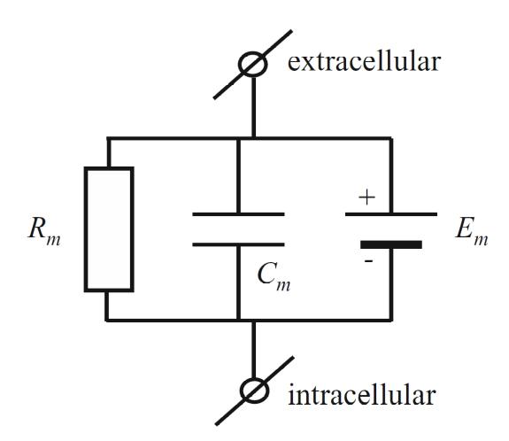
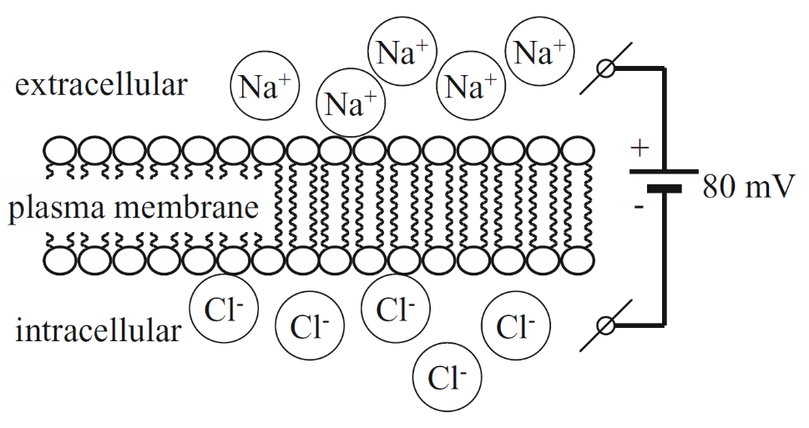
The cell membrane as a circuit
The cell membrane is a capacitor
  Insulation between intracellular and extracellular spaces
  Membrane potential (voltage source) → Electric field
  Molecules with opposite charges accumulate on either side
  The membrane capacitance is proportional to the membrane area
The cell membrane is a resistor
  Ions are blocked by a barrier with high resistance
  The number of open channels dictates the membrane resistance (Rm) and the amount of flow of ions (current)

Slide 8
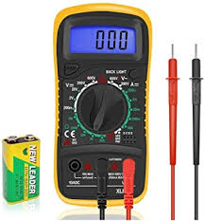
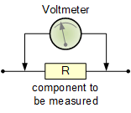
Measuring the membrane potential (voltage)
A voltmeter uses 2 probes to measure the voltage (potential) between 2 points
  Membrane potential → Between inside and outside the cell
  Field potentials → Between a tissue area and a reference point
To measure the voltage across the cell membrane
  2 electrical connections (electrodes), one intracellular and one extracellular
How to create an electrical connection with the inside of the cell?
  Sharp electrodes
  Patch-clamp

Slide 9
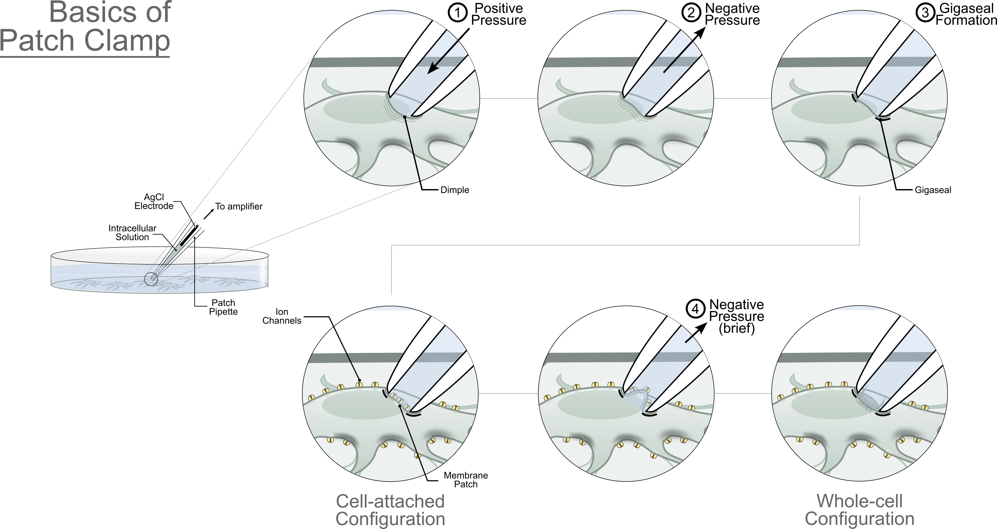
Single cell electrophysiology

Slide 10
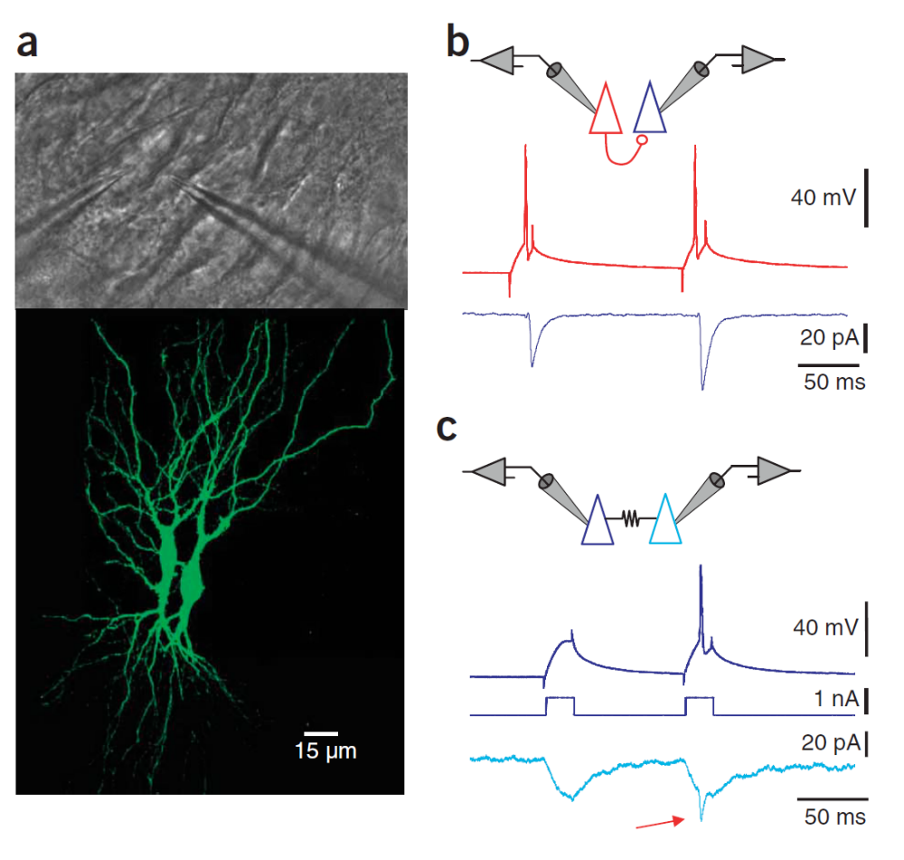
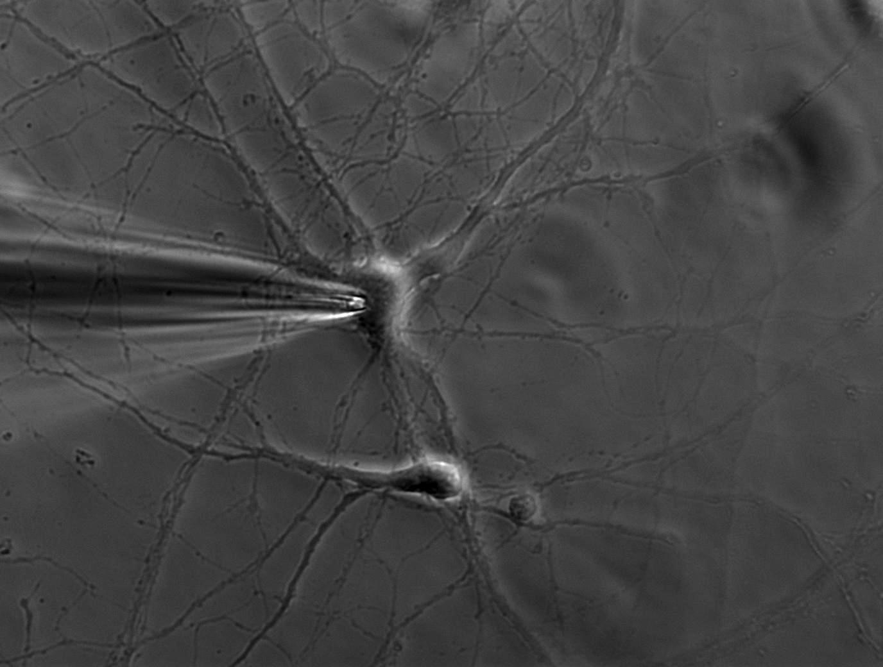
Single cell electrophysiology
Neuronal cultures
  Cells are easily distinguishable
  Easy to access to the cell to patch
Brain slices or in vivo
  The whole local network is intact
  Fluorescence labelling of neurons to visualize the entire neuronal morphology

Slide 11
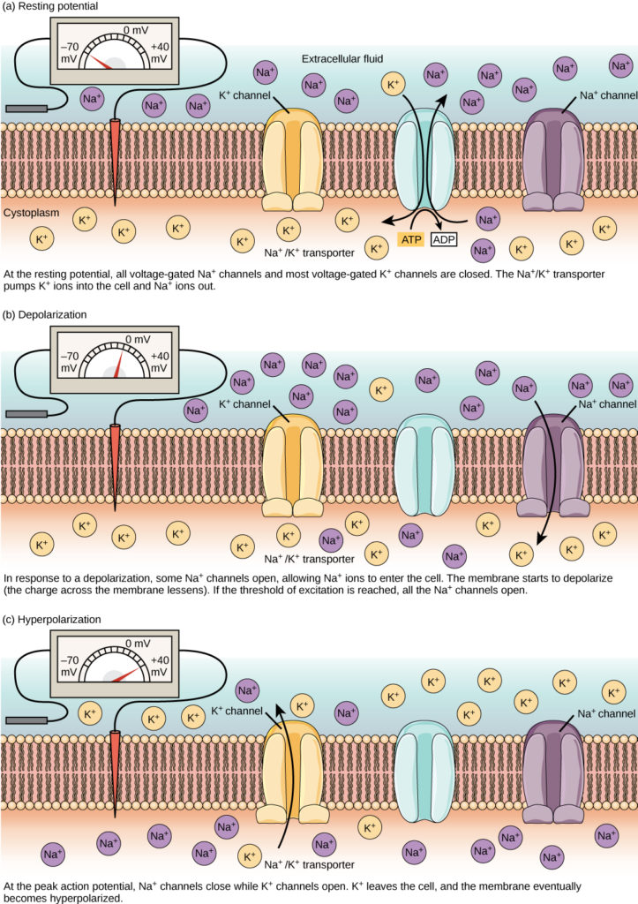
Action potential
At resting membrane potential
  Na⁺ and K⁺ channels are closed
Stimuli positively increase the membrane potential (voltage) (depolarization)
Upon reaching a voltage threshold, Na⁺ channels open
  Massive flow of Na⁺ ions inside the cell depolarizes even more the membrane potential
Further depolarization opens K⁺ channels
  Flow of K⁺ ions outside the cell reduces negatively the membrane potential (repolarization + hyperpolarization)
https://courses.lumenlearning.com/wm-biology2/chapter/resting-membrane-potential/

Slide 12
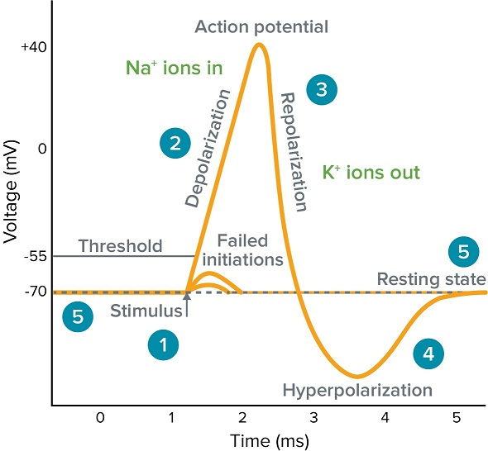
Action potential
At resting membrane potential
  Na⁺ and K⁺ channels are closed
Stimuli positively increase the membrane potential (voltage) (depolarization)
Upon reaching a voltage threshold, Na⁺ channels open
  Massive flow of Na⁺ ions inside the cell depolarizes even more the membrane potential
Further depolarization opens K⁺ channels
  Flow of K⁺ ions outside the cell reduces negatively the membrane potential (repolarization + hyperpolarization )
5
1
2
3
4
https://www.moleculardevices.com/applications/patch-clamp-electrophysiology/what-action-potential#gref

Slide 13
The refractory period
Na⁺ channels inactivate (absolute refractory period)
  No following action potential can be initiated
K⁺ channels are open (relative refractory period)
  Very strong stimuli can initiate an action potential
https://www.moleculardevices.com/applications/patch-clamp-electrophysiology/what-action-potential#gref

Slide 14
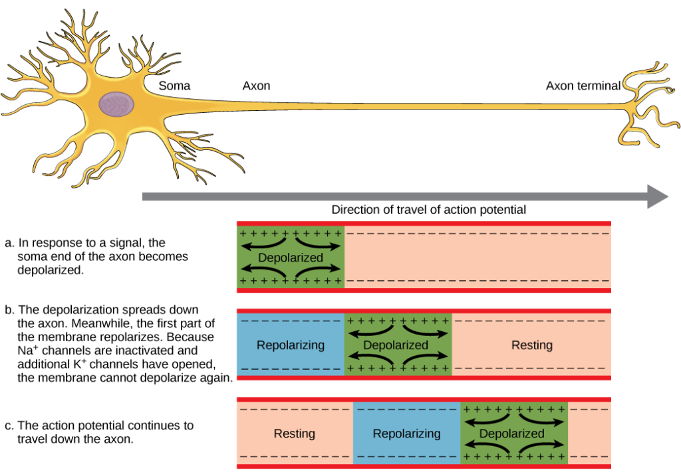
AP conduction and refractory period

Slide 15
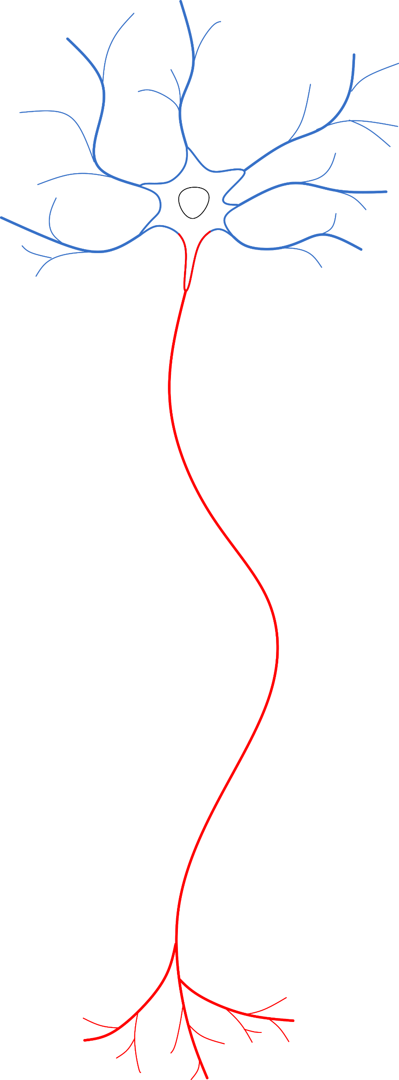
AP conduction and myelin
Ability to process multiple inputs into an output
Specialized morphology
  Multitude of inputs → Dendrites
  Output → Axon
  Input neuron or target neuron can be very distant (projecting)
Excitable
  Voltage-/Ligand-gated ion channels
Axon
Initial Segment (AIS)
Terminals

Slide 16
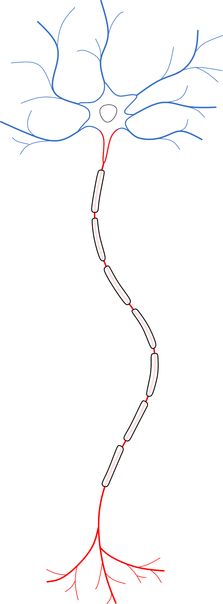
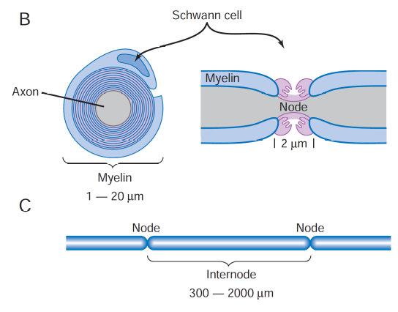
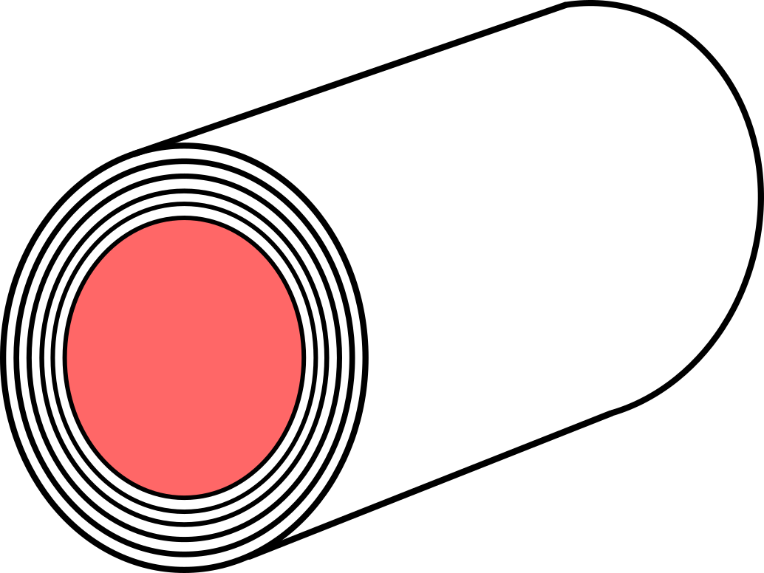
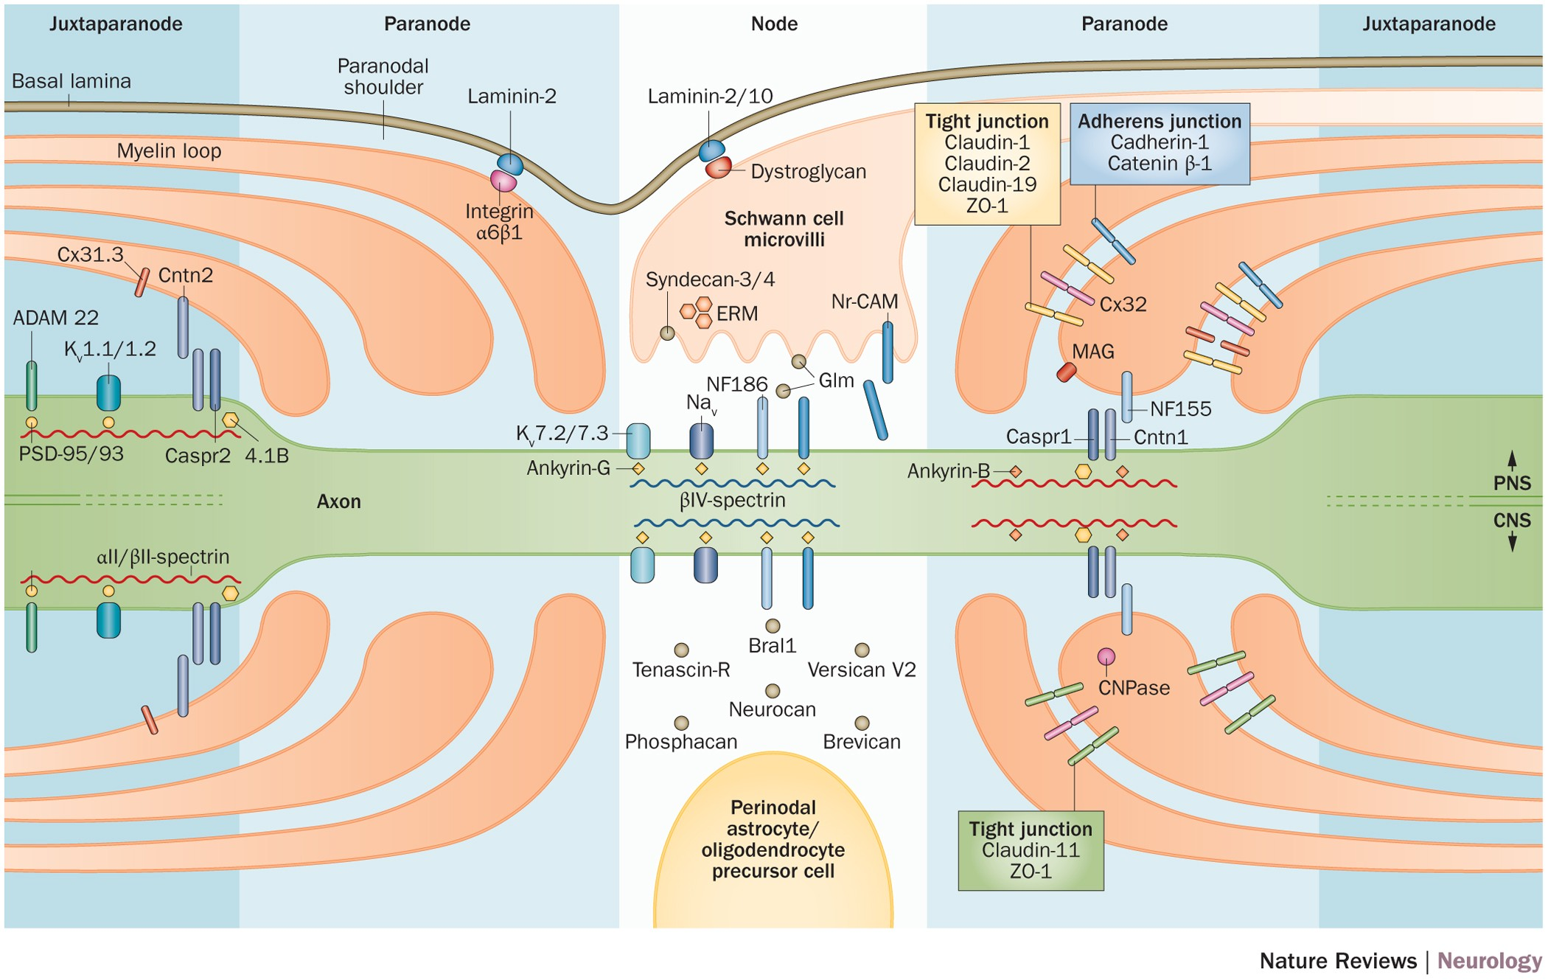
AP conduction and myelin
Ability to process multiple inputs into an output
Specialized morphology
  Multitude of inputs → Dendrites
  Output → Axon
  Input neuron or target neuron can be very distant (projecting)
Excitable
  Voltage-/Ligand-gated ion channels
  Fast conduction of signals (myelin)
Nodes of Ranvier have a high density of Na⁺ and K⁺ channels
Axon
Initial Segment (AIS)
Nodes of
Ranvier
Myelin sheaths
Terminals

Slide 17
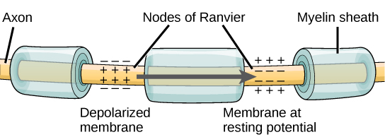
AP conduction and myelin

Slide 18
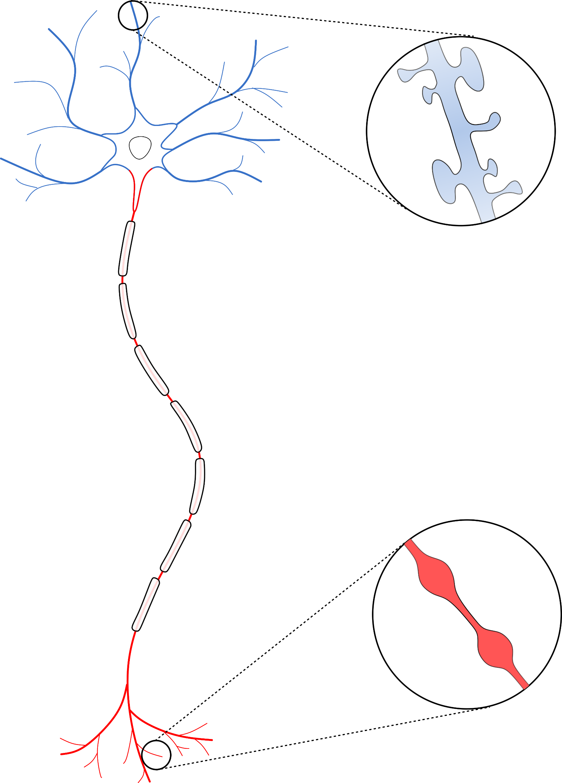
The neuron
Ability to process multiple inputs into an output
Specialized morphology
  Multitude of inputs → Dendrites
  Output → Axon
  Input neuron or target neuron can be very distant (projecting)
Excitable
  Voltage-/Ligand-gated ion channels
  Fast conduction of signals (myelin)
Axon
Initial Segment (AIS)
Dendritic
Spines
Nodes of
Ranvier
Myelin sheaths
Axonal Boutons
Terminals

Slide 19
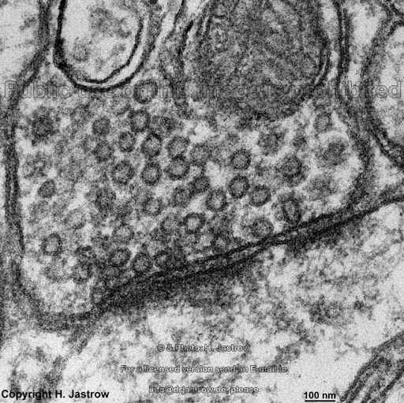
Neuronal output: the bouton
Boutons
Majority of neuronal connections (synapses) are chemical
  The signal is released by the bouton in small messenger molecules → Neurotransmitters
Neurotransmitters are contained in synaptic vesicles
  The vesicles fuse with the membrane, releasing the neurotransmitters into the synaptic cleft
  The release machinery fuses the vesicles and needs Ca²⁺ channels to work
  The identity (neuronal type) of the neuron is defined by the neurotransmitter
Synaptic
vesicles

Slide 20
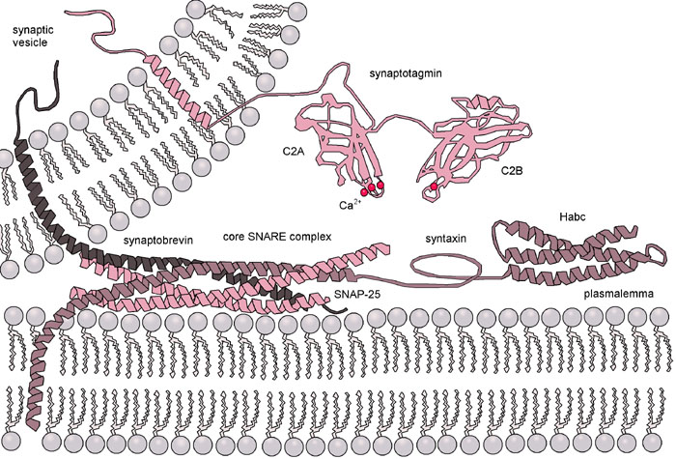
Neuronal output: the bouton
SNARE proteins in the release machinery forces the vesicle and the plasma membrane against each other, inducing their Ca²⁺-dependent fusion

Slide 21

The neurotransmitter
Main inhibitory
neurotransmitter
Main excitatory
neurotransmitter
https://www.compoundchem.com/2015/07/30/neurotransmitters/

Slide 22
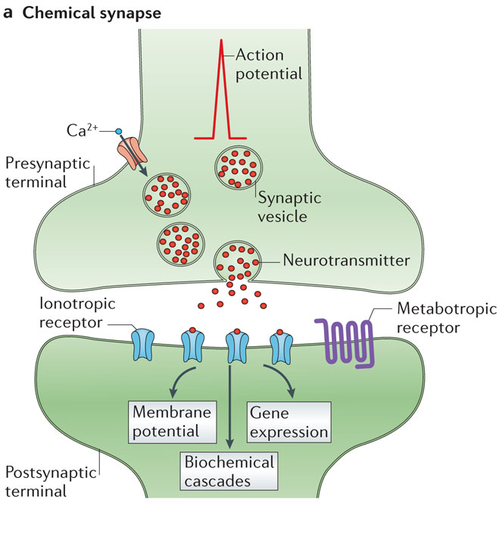
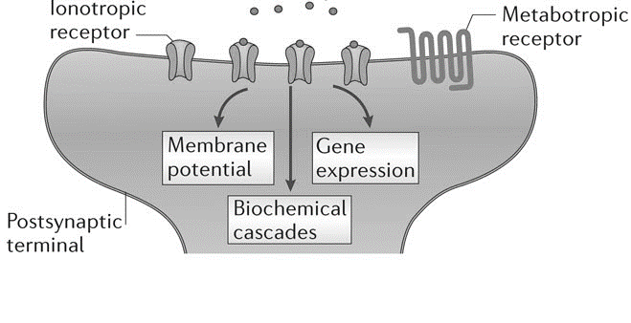
The synapse
Boutons are the presynaptic components of the synapse
  Neurotransmitters are released in the synaptic cleft
Dendritic spines are the postsynaptic components of the synapse
  The neurotransmitters bind to ligand-gated ion channels and metabotropic receptors
Synaptic
cleft
Dendritic
spines
Nature Reviews Neuroscience volume15, pages 250–263 (2014)

Slide 23
The Postsynaptic Density
Ion channels (ionotropic)
  NMDARs, AMPARs, KainateR
  GABA_{A} receptors
  Voltage-gated ion channels (Ca²⁺, K⁺, Na⁺)
GPCRs/TKRs
  Catecholamine receptors (Dopamine, Noradrenaline)
  Serotonin Receptors
  Glutamate metabotropic receptors
  GABA_{B} metabotropic receptors
  TrKB/BDNF
Transporters
Kinases/phosphatases
  CaMKII
  PKA
  PKC
  Src
  ERK
  PDEs
  PP-1
Adaptor proteins
  PSD-95/PSD-93
  Homer
  Shank
Cytoskeleton proteins
Synaptic
cleft
Postsynaptic density (PSD)
Nature Reviews Neuroscience volume15, pages 250–263 (2014)

Slide 24
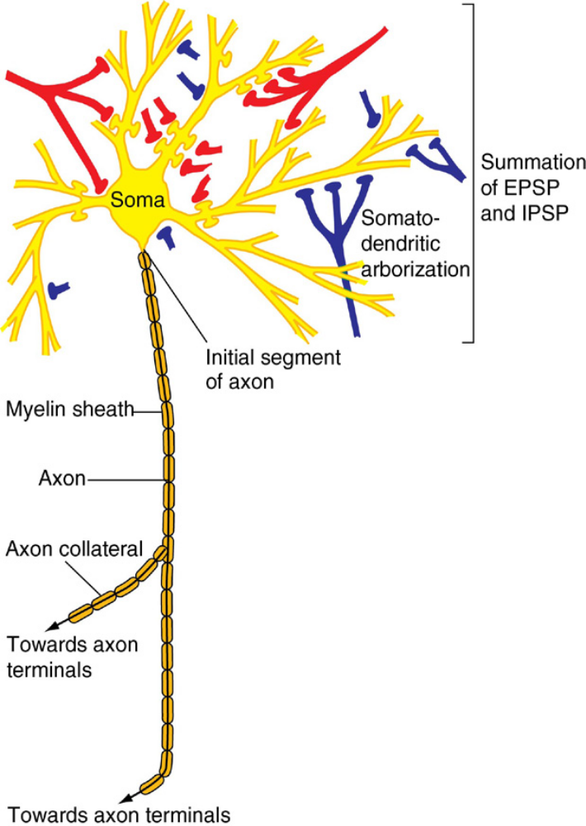
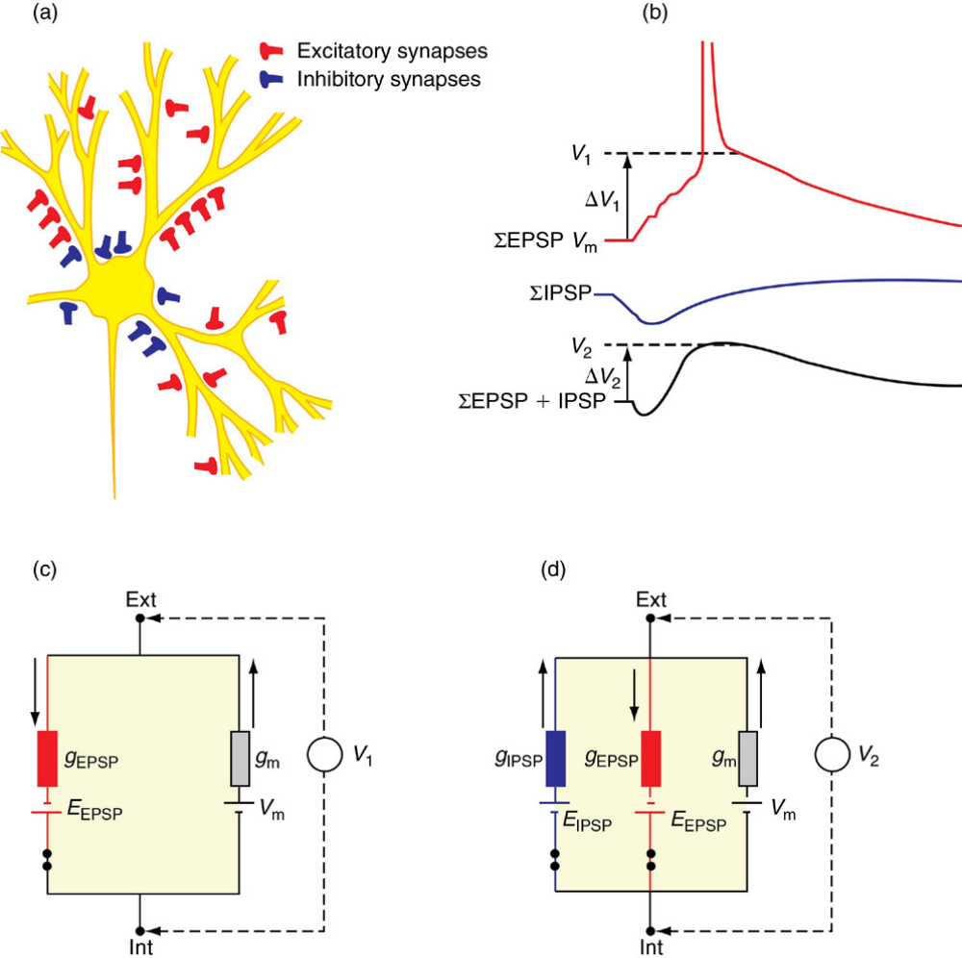
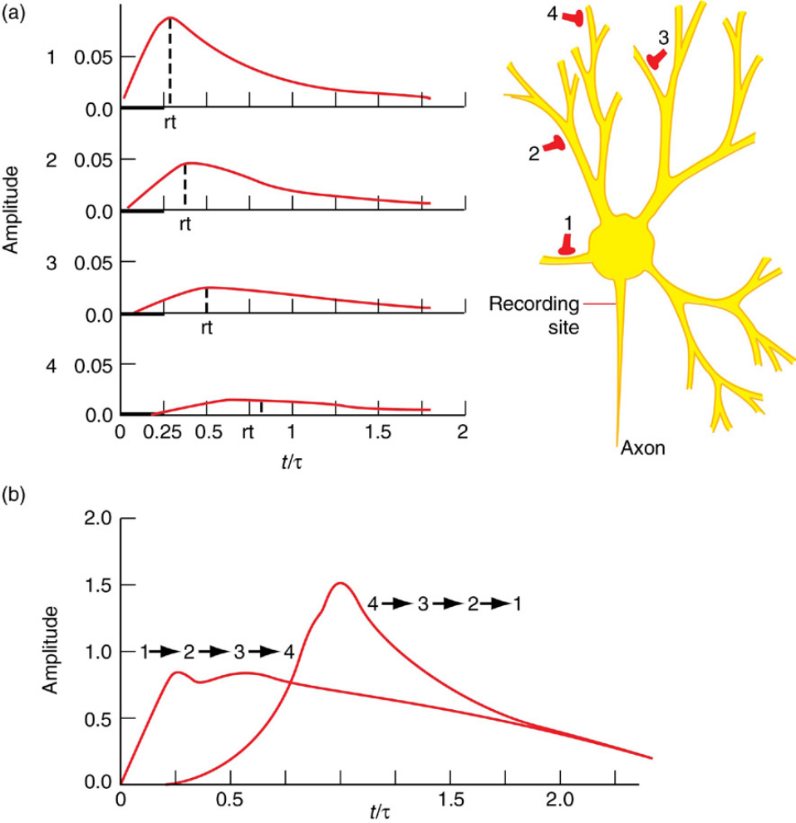
Neuronal signal integration
Each neuron receives numerous inputs
  Axo-dendritic
  Axo-somatic
  Axo-axonic (AIS and terminals)
When a synapse is activated, it will either generate:
  Excitatory Post-Synaptic Potential (EPSP)
  Inhibitory Post-Synaptic Potential (IPSP)
The summation of EPSPs and IPSPs will determine the level of depolarization reaching the soma

Slide 25
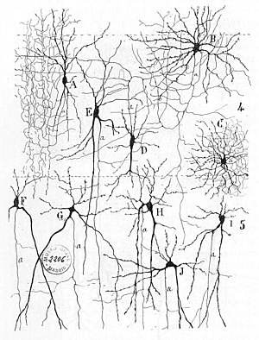
Neuronal networks
In the CNS 2 main types of neurons:
  Excitatory neurons - principal cells
  Inhibitory neurons - interneurons
In cortex and hippocampus
  Principal cells are the pyramidal cells (glutamatergic)
  Interneuron (GABAergic) types can be many (parvalbumin, somatostatin, etc)

Slide 26
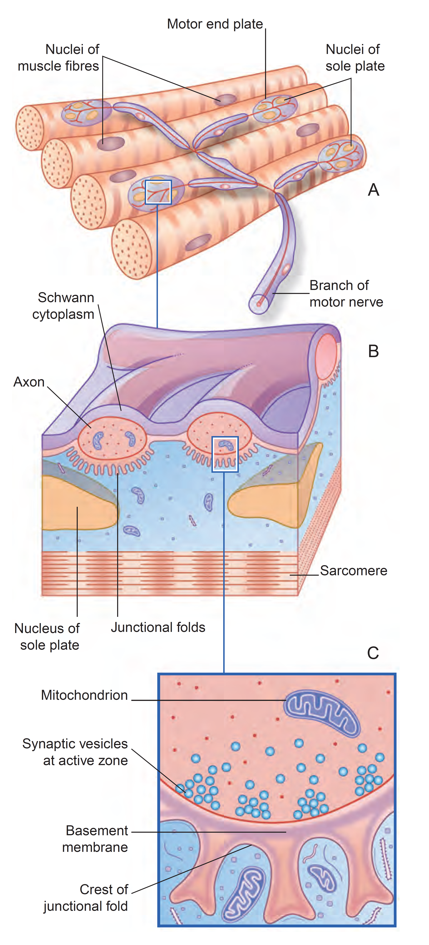
The neuromuscular junction
Motor neurons axonal terminals highly branch onto the muscle to form neuromuscular junctions (NMJ)
NMJ are rich in nicotinic receptors, which recognize acetylcholine
Nicotinic receptors opening allows Na⁺ and Ca⁺ to and depolarization of the muscle cell

Slide 27



Questions?
For follow-up questions:
vincenzo.mastrolia@kcl.ac.uk
Specific reading:
  Guyton and Hall - Textbook of Medical Physiology 12th ed (2011) ISBN: 978-0-8089-2400-5
  Constance Hammond – Cellular and Molecular Neurophysiology 4th ed (2015) ISBN: 978-0-12-397032-9
  Greg Stuart, Nelson Spruston, Micheal Häusser – Dendrites 3th ed (2016)
  ISBN 978–0–19–874527–3

